Slide 1
Automatic attendance tracker system
-Akhil D19003
-Kailash D19013
-Nikhil D19019
-Nishant D19020
-PrabhaTH D19022

Slide 2
Introduction
The present day attendance system is mostly manual.
It wastes a considerable amount of time both for teachers and students.
There are still chances for proxies in the class when attendance is taken manually.
Manual attendance always a have a cost of human error.
The attendance sheet further goes to the admin team to be updated.
So automating the attendance process will increase the productivity of the class.
In this proposed system we take the attendance using face detection recognition which recognizes the face of each student during the class hours using various techniques.

Slide 3
Problem Statement and challenges
To be able to give attendance in a better and faster manner using state of the art techniques.
To achieve face detection and recognition with the highest accuracy and to implement it such that the latency is less.
To look at various machine learning approaches to automate facial recognition system which is capable of detecting images rapidly and achieving high detection rates.
The end goal is to automate the process of attendance in a classroom, with just a click of a classroom picture.

Slide 4
Objectives
The tasks involved are the following:
To Detect the faces accurately.
To preprocess and augment the images such that training size would be large enough to learn.
To be able to recognize the face accurately.
To deploy the deep learning model
To create a simple user friendly GUI
Tools used

Slide 5

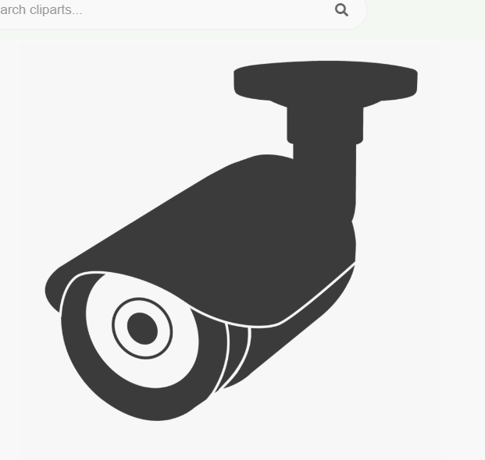



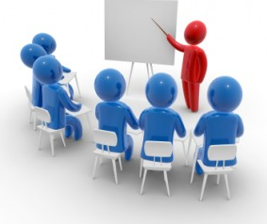



Diagrammatic Flow
CCTV Video footage of Classroom
Face Detection
Data Augmentation
Pre-Processing
Capturing an image from the CCTV footage.
AWS/Facenet
Training data
Face Recognition
Deployment
Accuracy and Results

Slide 6
data augmentation techniques

Slide 7
The standard techniques Used for data augmentation
The standard techniques which we used for data augmentation are :
Original image
Blurring images
Flipping images
Gamma Correction
Rotation
Histogram equalization

Slide 8
The Journey

Slide 9




The Beginning
A. IMAGE COLLECTION
Tkinter app for easy collection
Image collection
Folder arrangement
B. FACE DETECTION
Viola Jones
MTCNN

Slide 10
Recognition
Resnet Architecture
Training on Basic Images
Training on Augmented Images
Training on Augmented Images + Testing on SuperRes Images
Training on Augmented Images (100x100) + Testing on SuperRes Images
Training on Greyscale Images
Training on Augmented Downsized Images 1
Training on Augmented Downsized Images 2
Training on WebCam LowRes Images
Recognition using Facenet
Recognition using Amazon Rekognition

Slide 11
Deploying Attendance Tracker

Slide 12
Terms and Technologies
Rest API –
REpresentational State Transfer (REST) API is a way of accessing the web services in a simple and flexible way without having any processing.
Flask –
It is a Python micro-framework that is used to develop web applications and is based on the Werkzeug WSGI toolkit and Jinja2 template engine.
AWS Rekognition -
Amazon Rekognition is based on highly scalable, deep learning technology developed by Amazon’s computer vision scientists to analyze billions of images and videos daily.
Notes:
Rest-
This uses less bandwidth, simple and flexible making it more suitable for internet usage. It’s used to fetch or give some information from a web services. All communication done via REST API used only HTTP request.
Flask –
Werkzeug provides us the tools used to build communication between server and app. Jinja2 helps us to build a template with the responses from the applications and their placement in the webpage.

Slide 13
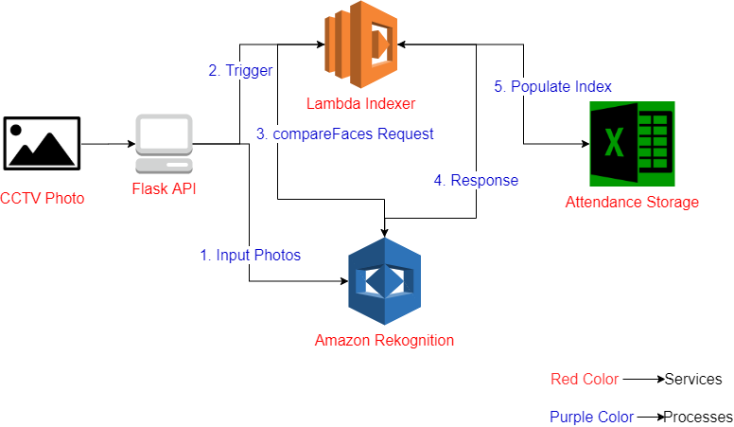
Architecture

Slide 14
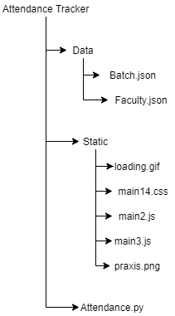
Flask Application Skeleton(Main)

Slide 15
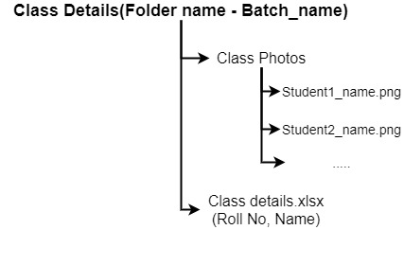
New batch folder structure

Slide 16
Live Demonstration of GUI

Slide 17
Future plans
Linking the application to praxis’s KK.
Creating a network such that when the class starts attendance would be taken from the CCTV automatically and would be generated in the form of excel to the admin team.
Amazon AWS could charge for their services or reduce the number of images that can be processed each month.
To mail all the absentees and the NA’s so that the attendance can be changed on updated real time.
People with drastic and sudden differences in facial features may be left unrecognized. The images used for recognition would then have to be updated.
To reduce the latency for application to generate results.

Slide 18
Acknowledgements
Firstly we would like to thank praxis business school for giving us this opportunity and resources to use during the capstone project.
We would like to take this opportunity to thank Prof. Gourab Nath for mentoring us with patience and offering critical advice during moments of import.
We would also like to thank Prof Utkarsh Vardhan for offering valuable advice and resources for the deep learning portions of our project.
We also offer our humble thanks to Prof. Charanpreet Singh, Prof. Prithwis Mukherjee and Sushant Saha for giving us a chance to prove ourselves.
Finally, we'd like to thank our parents and other esteemed members of Praxis who helped us make this project possible.

Slide 19
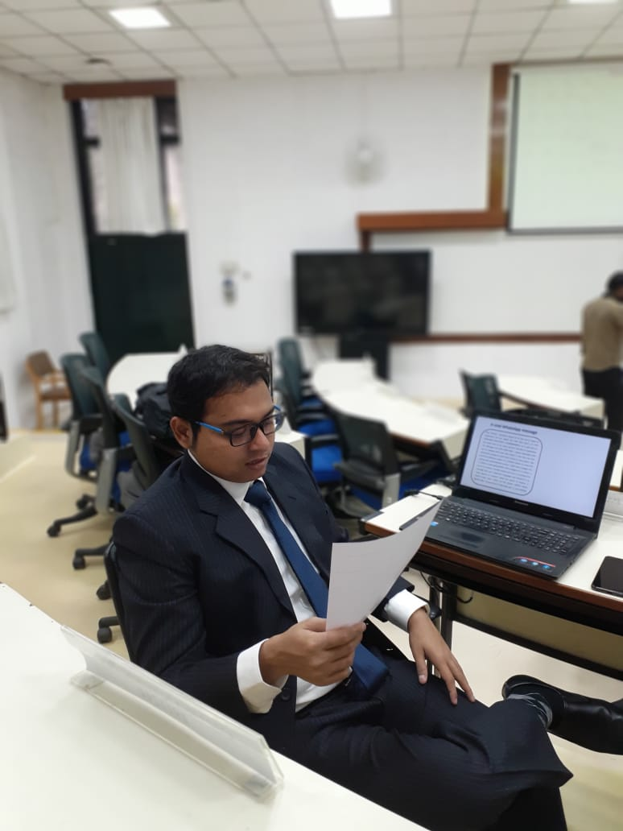

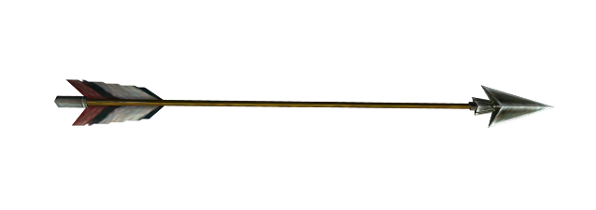

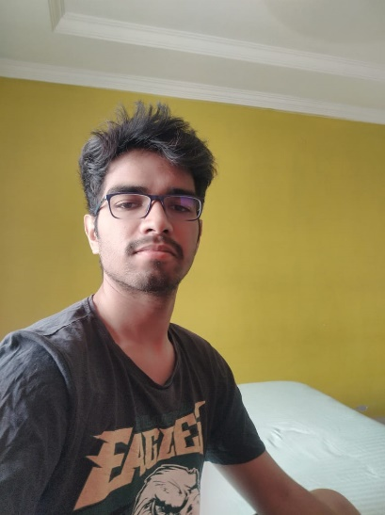
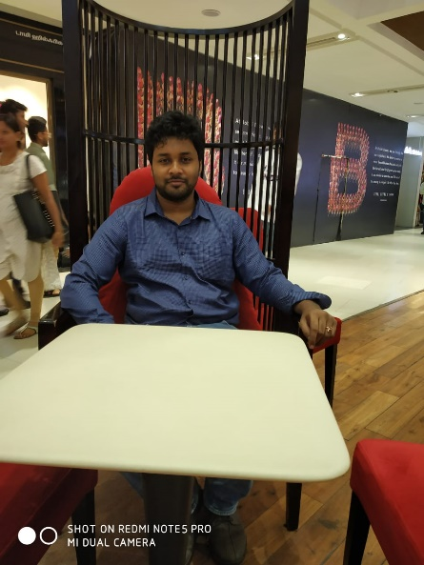

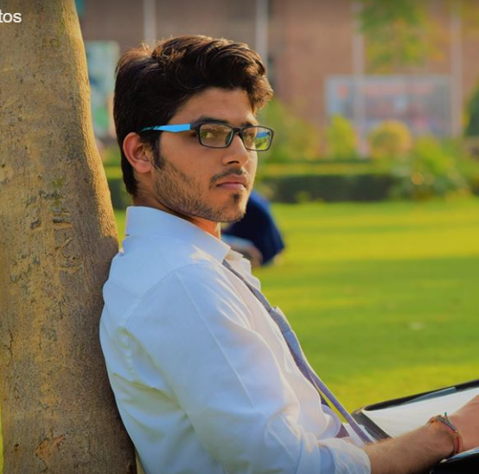
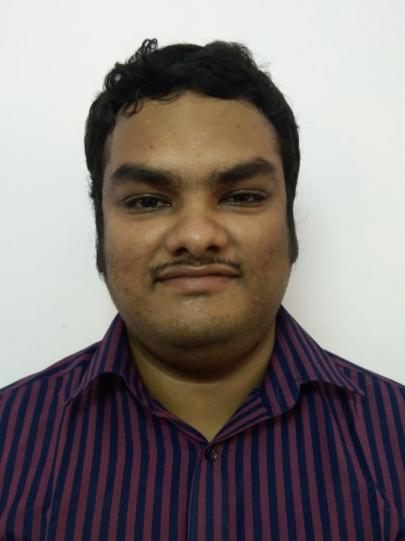
5 Pandavas
Prof. Gaurab Nath
Aka
Krishna
Akhil
Aka
Bhima
Kailash
Aka
Sahadeva
Nikhil
Aka
Nakula
Nishant
Aka
Yudhishthira
Prabhat
Aka
Arjuna

Slide 20

Thank you For your Attendance

Slide 22
Backups

Slide 23






Tools used

Slide 24
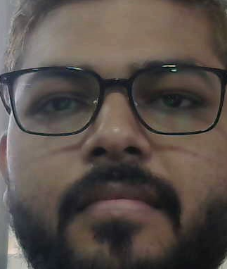
Original Image

Slide 25



Blurring images

Slide 26
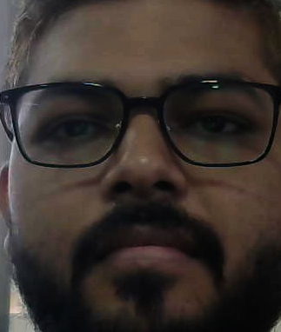
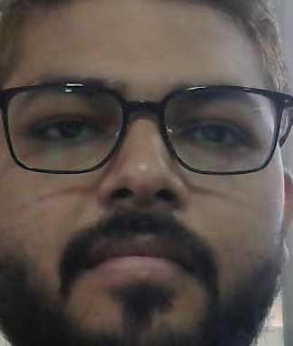
Flipping images

Slide 27
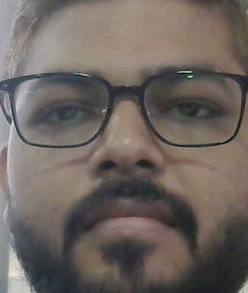
Gamma Correction

Slide 28
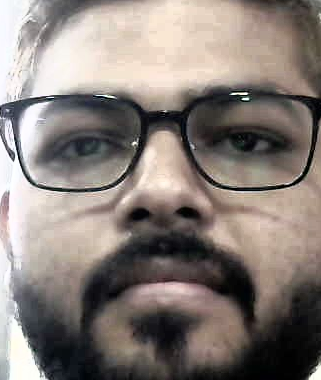
Histogram Equalization

Slide 29
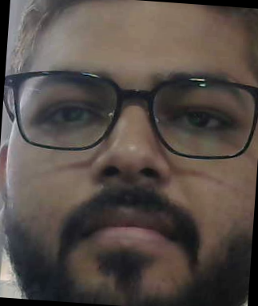
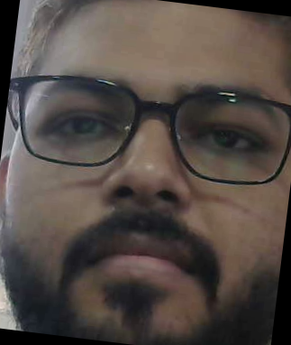
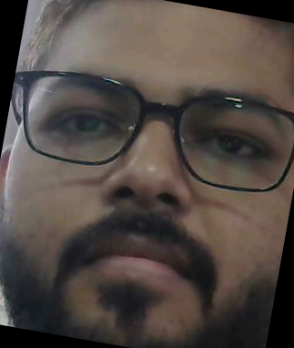
Rotation

Slide 30
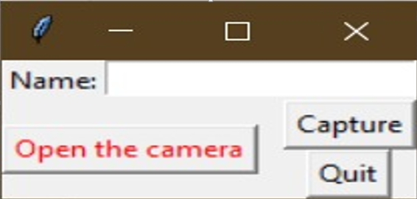

Slide 31
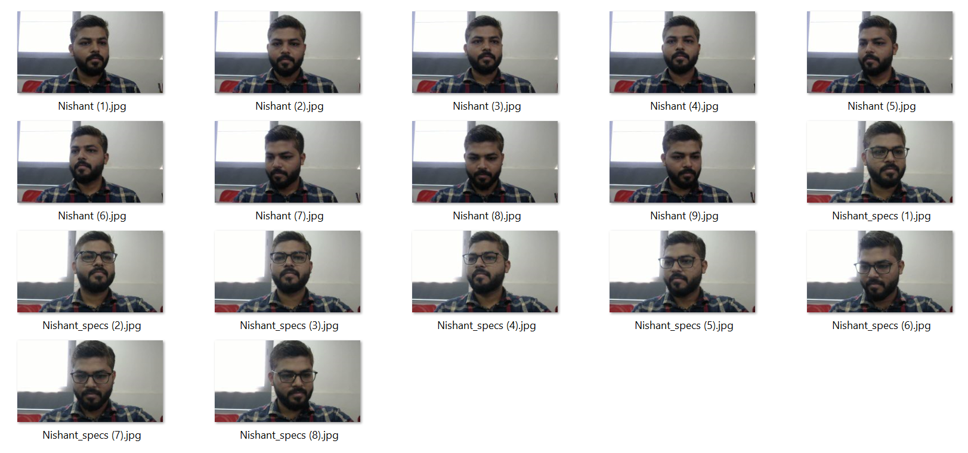

Slide 32
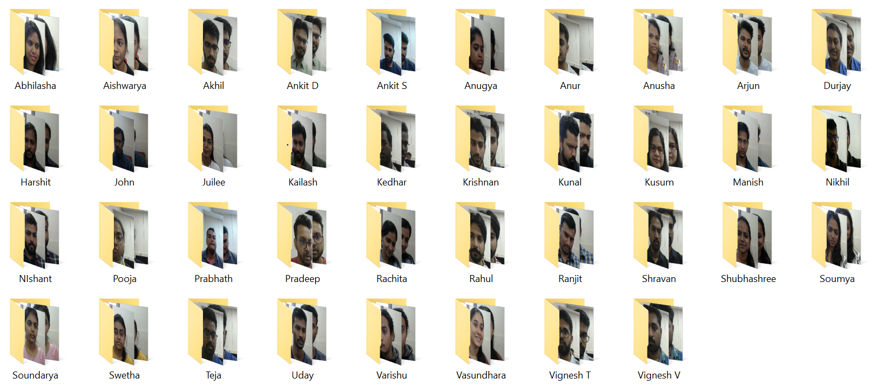

Slide 33
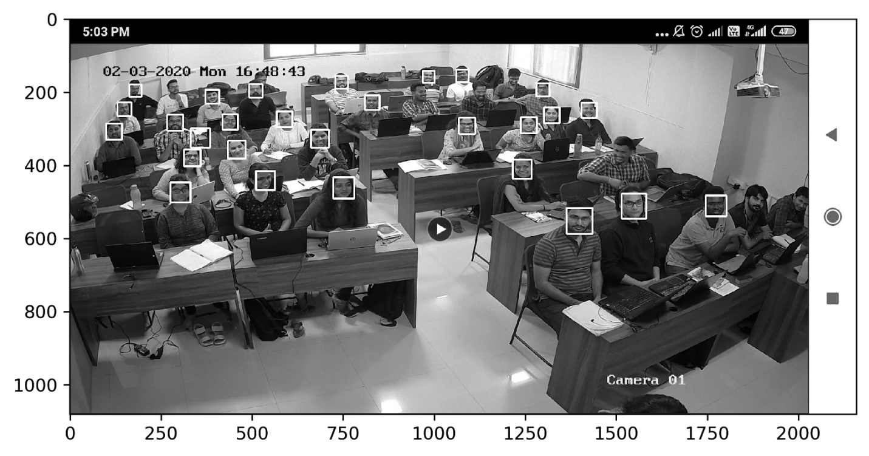

Slide 34
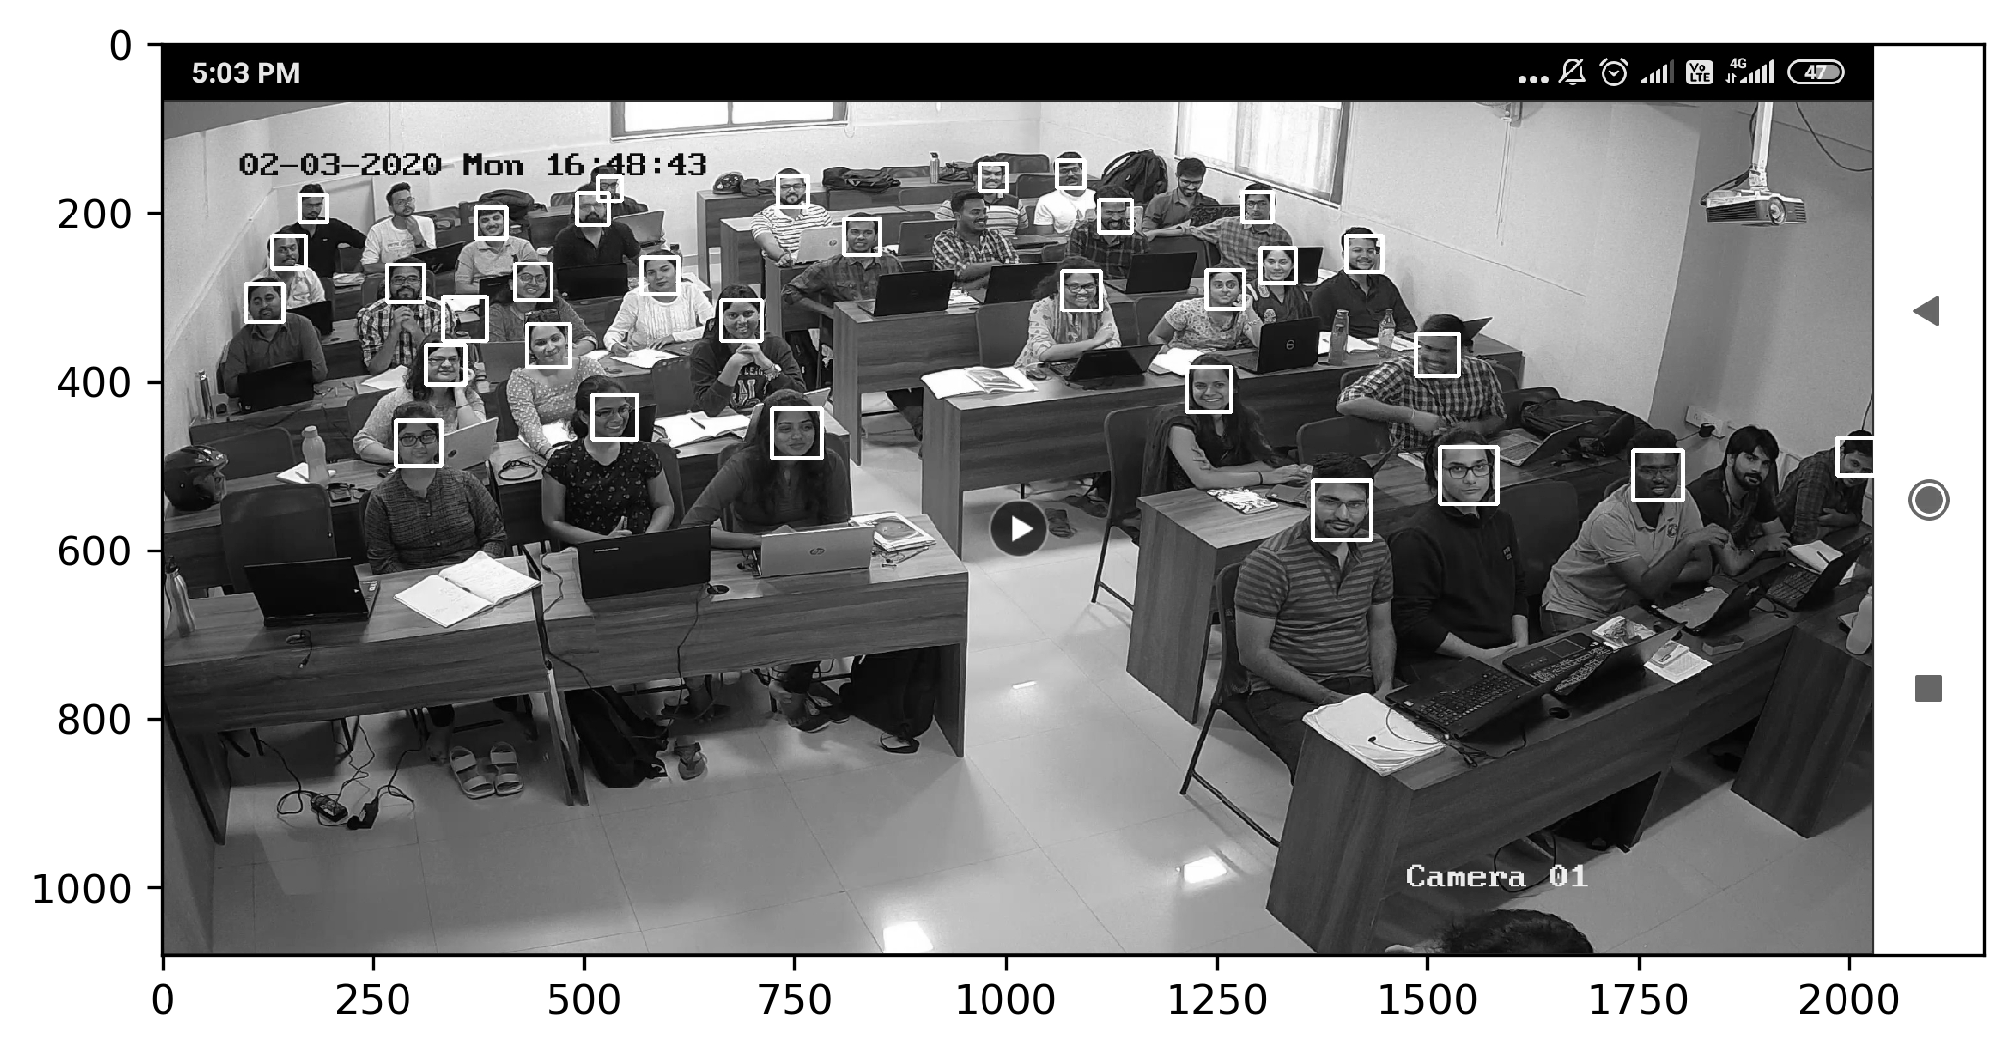

Slide 35
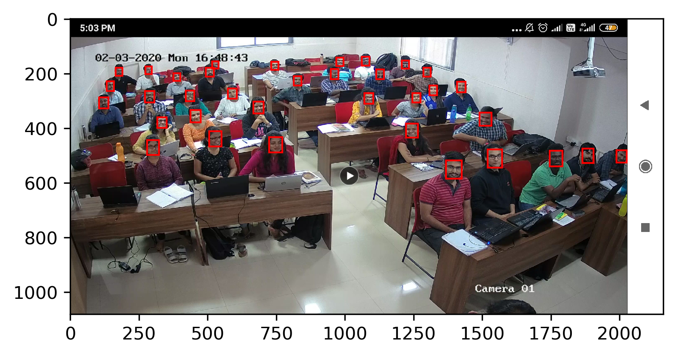

Slide 36
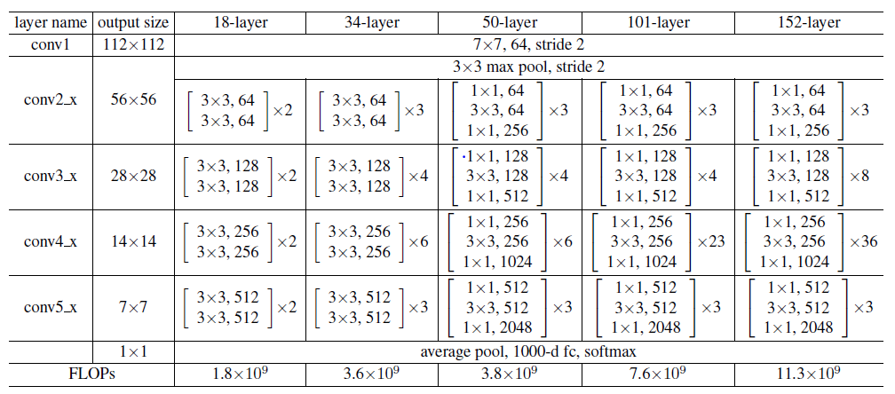
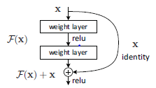

Slide 37
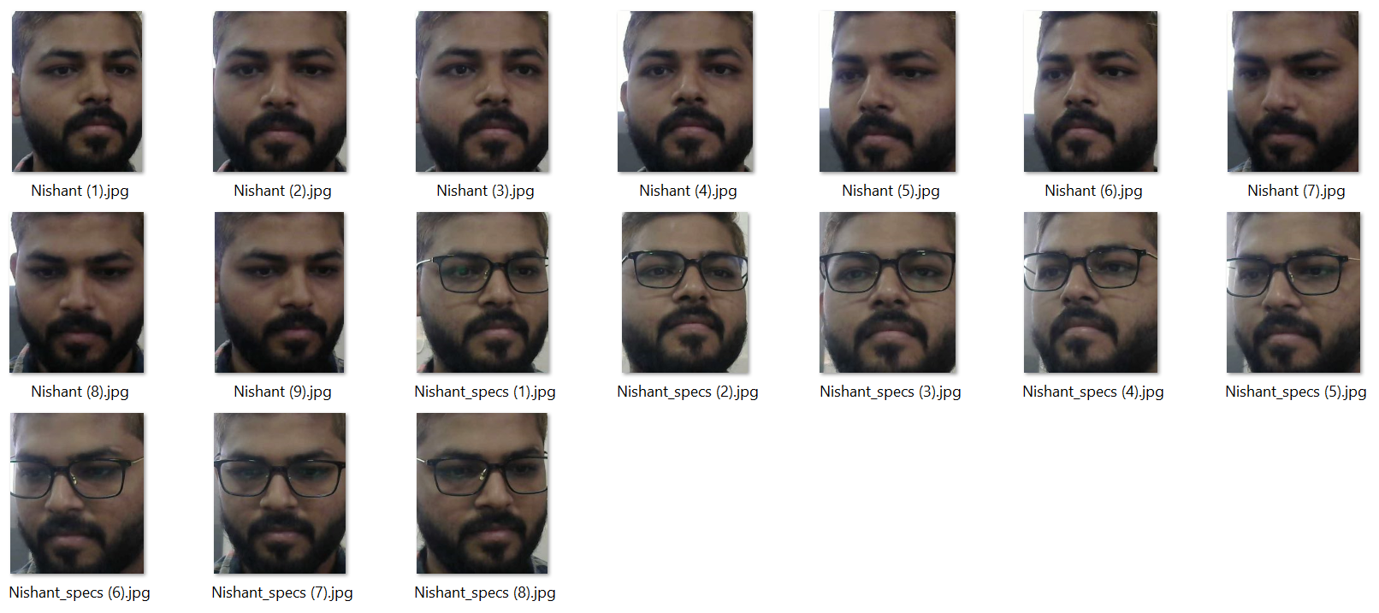
Training data- 500 images originally captured
Testing data- Images captured on phone
Testing Accuracy- 11.5%

Slide 38
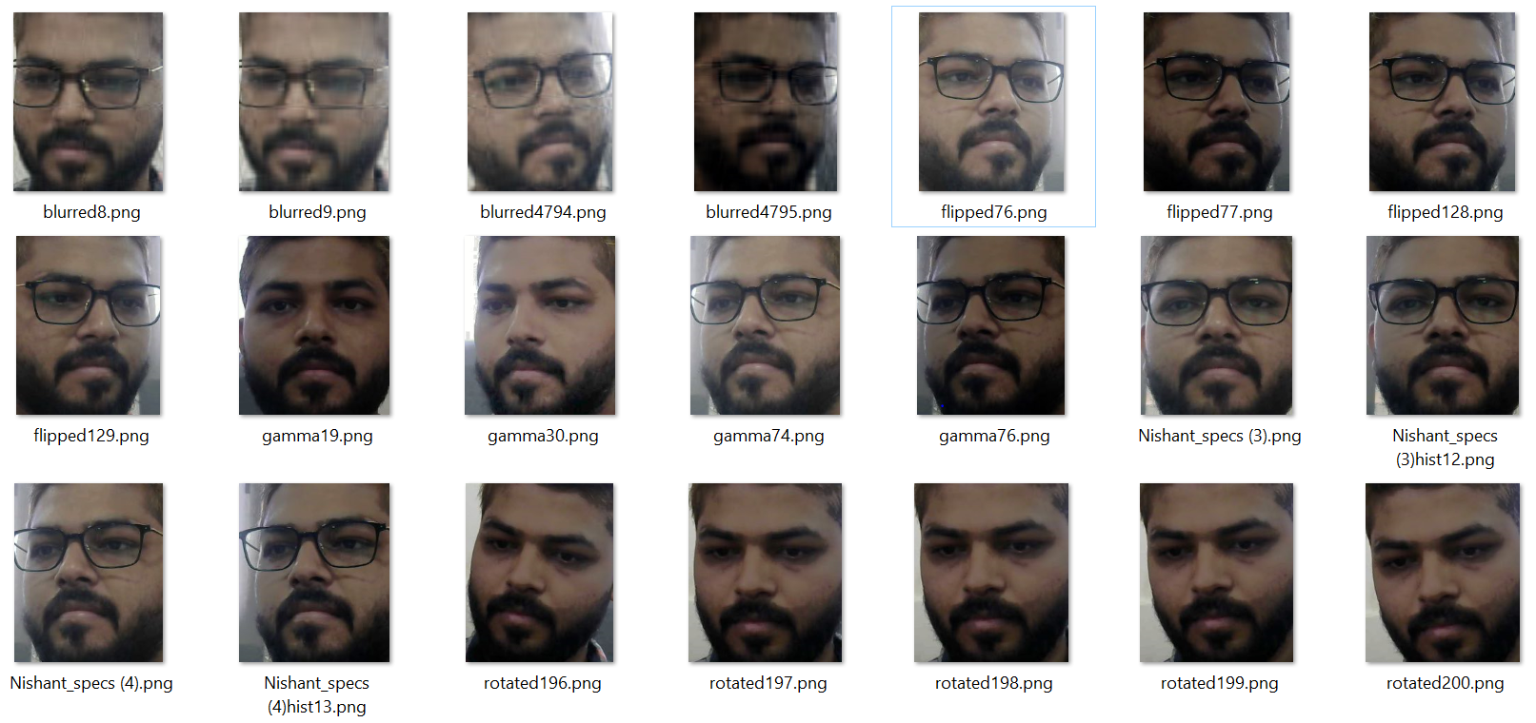
Training data- 2 lakh images obtained by augmenting original data
Testing data- Images captured on phone
Testing Accuracy- 38.5%

Slide 39
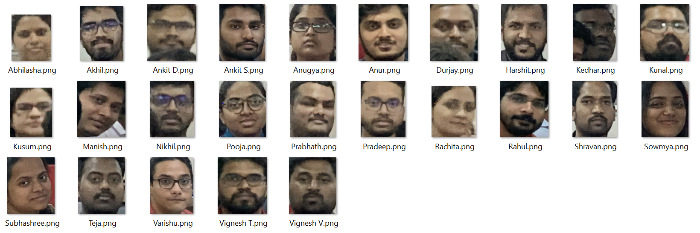
Training data- 2 lakh images obtained by augmenting original data
Testing data- Super Resolution form of images captured on phone
Testing Accuracy- 35.5%

Slide 40
Training data- 2 lakh images obtained by augmenting original data with input size of 100x100
Testing data- Super Resolution form of images captured on phone
Testing Accuracy- 42.5%

Slide 41
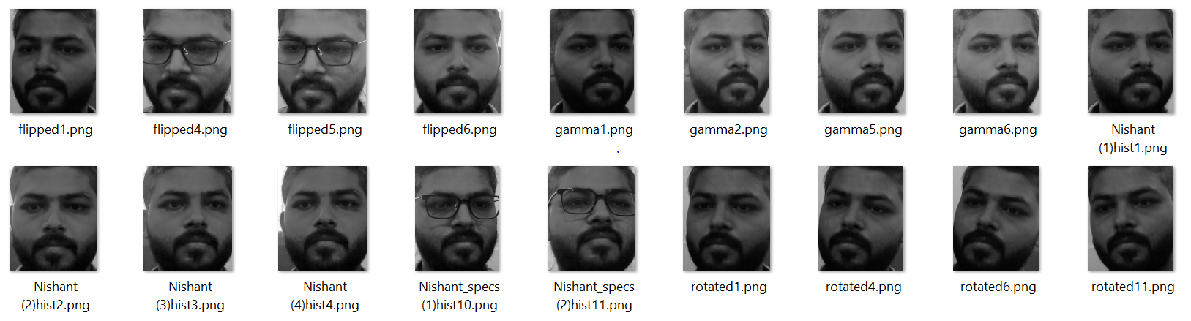
Training data- 96000 images obtained by augmenting original data
Testing data- Grey Scale form of images captured on phone
Testing Accuracy- 27%

Slide 42
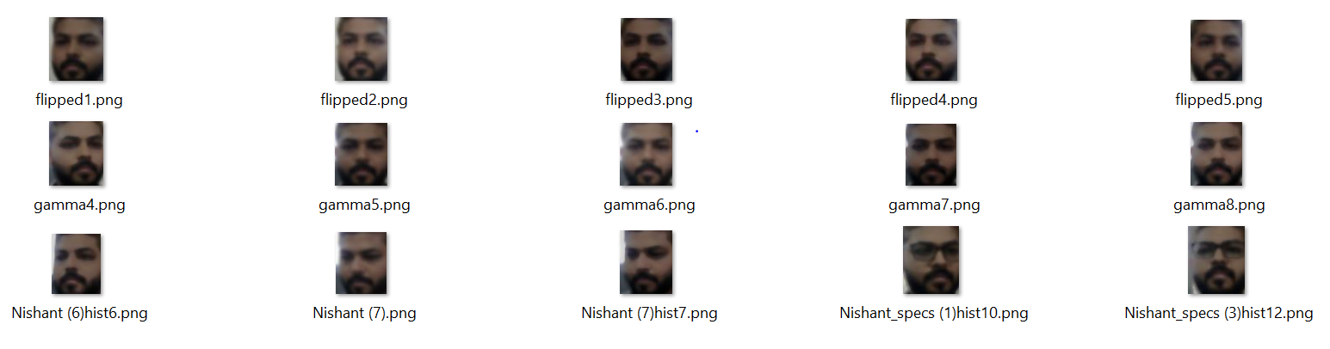
Training data- 6000 images obtained by augmenting double resized data
Testing data- Images captured on phone
Testing Accuracy- 11.5%

Slide 43
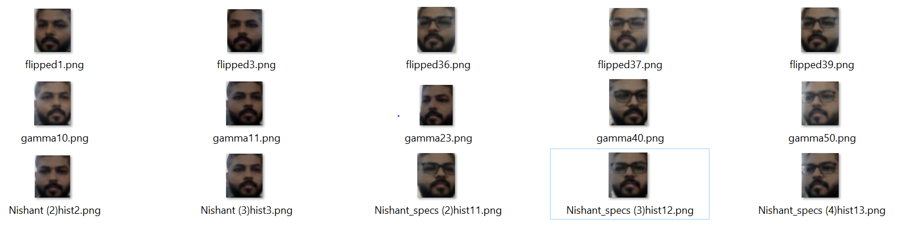
Training data- 6000 images obtained by augmenting single resized data
Testing data- Images captured on phone
Testing Accuracy- 23%

Slide 44
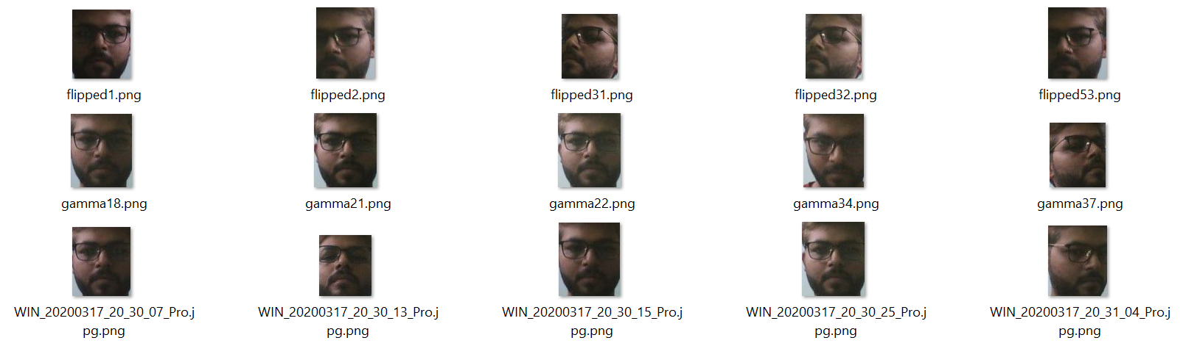
Training data- 500 images obtained by augmenting low res webcam images (6 Classes)
Testing data- Images captured on phone and CCTV
Testing Accuracy- 67%

Slide 45
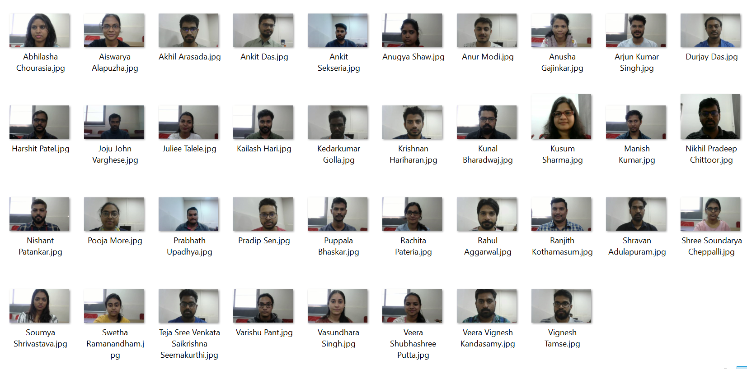
Training data- 1 image per person
Testing data- Images captured on phone & CCTV
Testing Accuracy- 90% & 80%

Slide 46
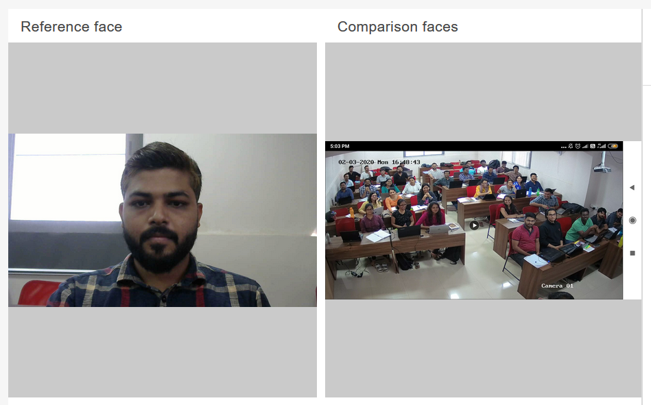
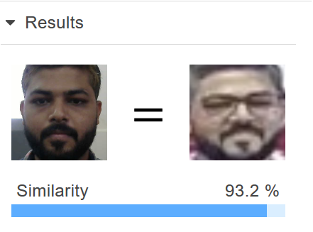
Training data- 1 image per person
Testing data- Images captured on CCTV
Testing Accuracy- >95%

